Slide 1



Introduction to Threats and Vulnerabilities in Computer Networks
The interconnected world of computers and networks is enabling constant communication and information sharing.
However, this interconnectedness also opens the door to various threats and vulnerabilities that can compromise the security and integrity of our systems. Threats can originate from malicious individuals, organized groups, or even unintentional errors.
Vulnerabilities are inherent weaknesses in the design, implementation, or configuration of software, hardware, or network systems. They act as entry points for attackers to gain unauthorized access, steal data, disrupt operations, or cause damage. Understanding these threats and vulnerabilities is crucial for developing effective security strategies and protecting our valuable digital assets.

Slide 2


Understanding Attack Surface and Attack Vector
Attack Surface
Attack Vector
The attack surface refers to the total area of a system or network that is exposed to potential attacks. It encompasses all the points of entry that an attacker could exploit, including operating systems, applications, network protocols, and even physical devices. The larger the attack surface, the more opportunities attackers have to find weaknesses and compromise the system.
The attack vector represents the specific method or technique an attacker uses to exploit a vulnerability and gain access to a system. Think of it as the pathway or route an attacker takes to reach their target. Common attack vectors include malicious code, phishing emails, social engineering, brute-force attacks, and network vulnerabilities.

Slide 3
Key Difference Between Attack Vector and Attack Surface
Attack Surface
Attack Vector
The overall area exposed to potential attacks.
The specific method or technique used to exploit a vulnerability.
Represents the collection of potential entry points.
Focuses on the breadth of vulnerabilities.
Represents the pathway or route taken to reach the target.
Focuses on the method of attack.

Slide 4


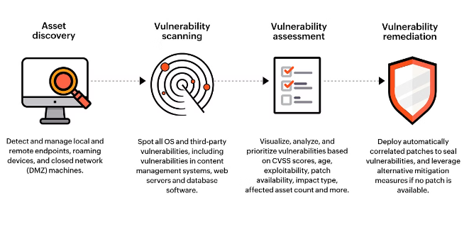


Exploiting Vulnerable Attack Surface Using Attack Vector
Identify Vulnerable Attack Surface
Attackers first scan the target system or network to identify potential weaknesses. They might search for outdated software, unpatched vulnerabilities, open ports, or misconfigured services. This is like finding a weak spot in a wall.
Choose an Attack Vector
Once a vulnerability is identified, attackers select an attack vector to exploit it. For example, they might choose to send a phishing email, exploit a known software flaw, or attempt a brute-force attack on a password.
Execute the Attack
Attackers use their chosen attack vector to exploit the identified vulnerability. This could involve sending malicious code, manipulating user input, or bypassing security controls. This is the moment they use their tools to breach the wall.

Slide 5


Practical Example of Attack Surface and Attack Vector Exploitation
1
Attack Surface: Web Application
Imagine a company's website, offering online shopping services. The website's functionality, user accounts, payment gateways, and database systems represent the attack surface. Attackers can target these components.
2
Attack Vector: SQL Injection
Attackers might exploit a vulnerable form field on the website, injecting malicious SQL code into the website's database. This could allow them to steal customer data, change prices, or even delete critical data.
3
Exploitation
The attackers use their knowledge of the SQL Injection vulnerability to gain unauthorized access to the website's database.
They can then steal sensitive information such as customer data, financial records, or intellectual property.

Slide 6


Techniques for Identifying Attack Surface and Attack Vectors
1
Vulnerability Scanning
2
Penetration Testing
Automated tools are used to scan networks and systems for known vulnerabilities. They identify missing security patches, outdated software, and open ports. These tools can pinpoint potential attack surfaces.
Security professionals simulate real-world attacks to identify vulnerabilities that may not be detected by automated scanning. This involves ethical hacking techniques to test the system's defenses and discover potential attack vectors.
3
Log Analysis
4
Threat Intelligence
Examining system logs, network logs, and application logs can reveal suspicious activities, failed login attempts, and unusual patterns. This can help identify potential attack vectors and compromised systems.
Gathering intelligence about known threats, attackers, and attack vectors is crucial. This information helps organizations stay ahead of emerging threats and proactively secure their systems against known vulnerabilities.

Slide 7

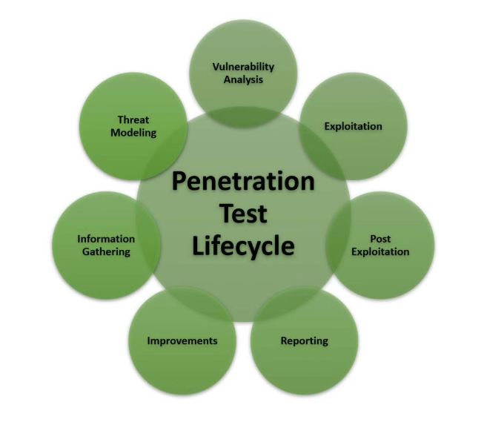
Penetration Testing and Vulnerability Assessment Methodologies
Method
Description
Black Box Testing
The tester has no prior knowledge of the system or its security measures.
White Box Testing
The tester has full access to the system's source code, documentation, and configuration details.
Gray Box Testing
The tester has limited knowledge of the system, typically including access to some documentation or user accounts.

Slide 8






Mitigating Attacks by Reducing Attack Surface and Securing Attack Vectors
Patch Management
Network Segmentation
Regularly updating software and operating systems with security patches is crucial. Patches address known vulnerabilities, reducing the attack surface and preventing attackers from exploiting them.
Dividing a network into smaller, isolated segments limits the impact of a successful attack. If an attacker compromises one segment, they cannot easily access other parts of the network.
Principle of Least Privilege
Multi-Factor Authentication (MFA)
Users and applications should only have access to the resources they need to perform their tasks. This reduces the potential for unauthorized access and data breaches.
Requiring multiple forms of authentication, such as a password and a one-time code, makes it harder for attackers to gain unauthorized access to accounts.

Slide 9
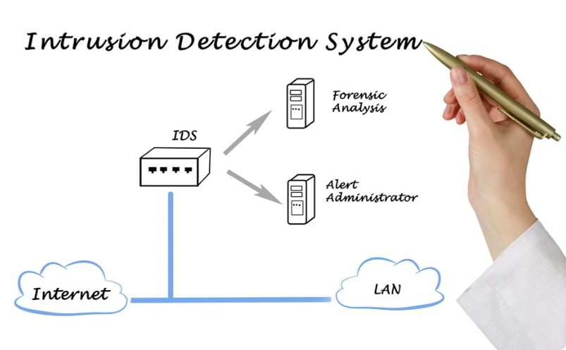
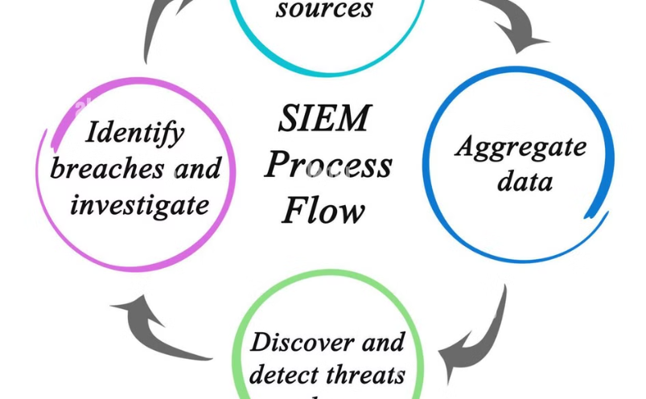
Implementing Robust Security Controls and Monitoring Mechanisms
Intrusion Detection Systems (IDS)
Security Information and Event Management (SIEM)
IDSs monitor network traffic for suspicious activity and alert administrators to potential attacks. They can identify and block malicious traffic, protecting systems from known threats.
SIEMs collect and analyze security data from various sources, providing a centralized view of security events and potential threats. They help detect anomalies, identify attack patterns, and respond to security incidents.

Slide 10


Conclusion and Recommendations for Network Security Best Practices
By understanding the concept of attack surface and attack vector, implementing robust security controls, and continuously monitoring network activities, organizations can effectively mitigate security threats and protect their valuable digital assets. Adopting a layered security approach, utilizing advanced security technologies, and staying informed about emerging threats are crucial for ensuring the safety and integrity of our computer networks in today's interconnected world.

